Slide 1
WATER PURIFICATION USING SOLAR ENERGY
Student 1 :7376211EC247
PAVITHRAADEVI S V
Student 2 :7376211EC165
JAISHREEDEVAKI T
Student 3 :7376211EC313
VINISHA K
Student 4 :NA

Slide 2
Abstract :
Every year million of people,most of them children ,die from disease associated with inadequate water supply,sanitation,and hygiene.More than two and a half billion people have gained access to improved drinking source since1990,but 666 million people are still without.Each day,nearly 1000 children die due to preventable water and sanitation related diarrhoeal disease.
Process in purifying water using solar energy :
● As solar power is a renewable resources which is used to purify water, these problems can be avoided.
● It is the advancement of the current water purification system.
● In this paper we presented the methodology of the solar water purifier.
● Energy source in this purifier is solar power and energy is stored in the battery.
● Fundamental parts of a sunlight based water purifier are sun powered charger, battery,bwarming loop, separating chalk, twofold layer condenser and a few water vessels.
● This purifier uses a filtering mechanism which removes dirt from water and a boiling mechanism which kills organisms.
● Through this process, pure drinking water is achieved.

Slide 3
Problem Statement Addressed :
● Consistently a large number of individuals, the majority of them youngsters, pass on from sicknesses related with insufficient water supply, sterilization, and cleanliness.
● It is assessed that by 2050, the greater part of the total populace will live in water focused on districts, according to specialists at MIT.
● More than over two billion individuals have accessed superior drinking water sources beginning around 1990, however 666 million individuals are still without.
● Somewhere in the range of 1990 and 2015, the extent of the worldwide populace utilizing a superior drinking water source expanded from 76% to 91%, be that as it may, every day, almost 1000 youngsters pass on because of preventable water and disinfection related diarrhoeal infections

Slide 4
Existing Solution to the Problem Addressed:
In order to develop water quality by diminishing contamination, taking out unloading and limiting arrival of unsafe synthetics and materials, dividing the extent of untreated wastewater and significantly expanding reusing and safe reuse universally.
Solar water purifier reduces water borne diseases as it is considered as an effective method of pathogen contaminated purification .
By using this method , we can able to achieve safe and affordable drinking water .
With the help of solar water purifier we can also conserve electricity .

Slide 5
Proposed Solution to the Problem Addressed:
The aim of our project is to purify water by using solar energy in rural areas.
● We are using solar energy because in rural areas the amount of electricity is not sufficient
● The sun rays is available in our country and by using this sun ray , we will produce electricity .
● Solar water purifier does not require electricity and does not waste water , so it is a easier way to purify water in rural areas and urban areas.
● Solar energy is utilized by this water purifier for the purification process. Water is purified through two phase cleaning processes, first filtering the water at that point of entry , then boiling it. Filtering eliminates pollutants from polluted water and afterward boiling kills existing organisms .
Other mechanisms are temperature control system and energy conservation and storage mechanisms.

Slide 6
Project Work Plan:
In this purifier, solar power is utilized as energy source and energy is put away in a battery. Right away, water is filtered by filtering chalk to eliminate soil and pollutants.
Then, at that point, utilizing solar energy, it boiling water by utilizing a heating coil.Water at room temperature is gained after condensation by a twofold layer condenser.
Through this interaction, pure drinking water is achieved. Energy stored in the battery can be utilized around evening time and cloudy days.
Water is purified by two stages:
1. Filtering 2.Boiling
Followed by temperature control mechanism and energy conservation and storage mechanisms.

Slide 7
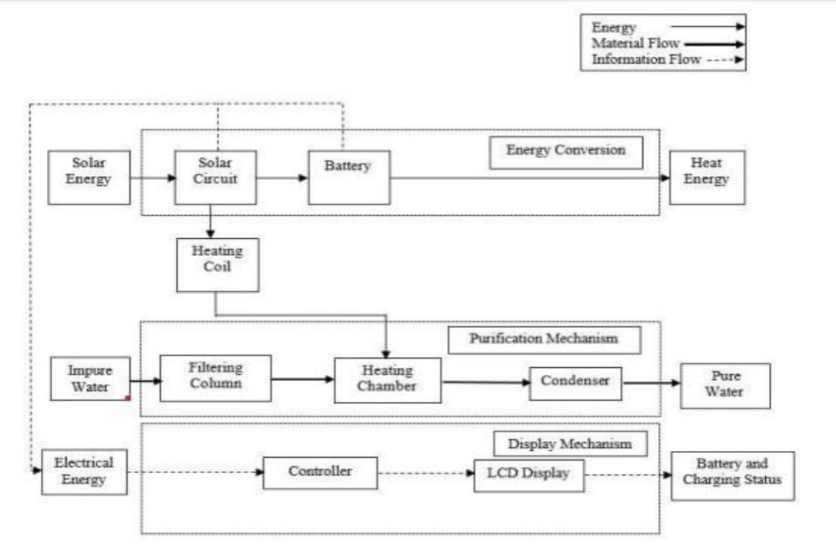
Block Diagram :

Slide 8
Flow Chart
(Which explains the Project work flow for various conditions)

Slide 9
Effective utilization of the Modern Tool & Cloud
Implementation, Testing & validation and usage of website or App or anything
Name of the cloud platform & reason for choosing the same need to be explained

Slide 10
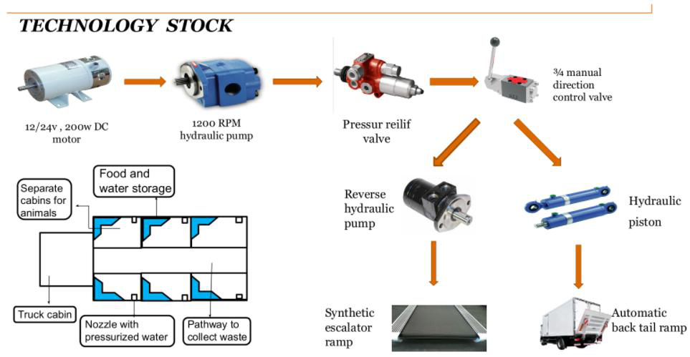
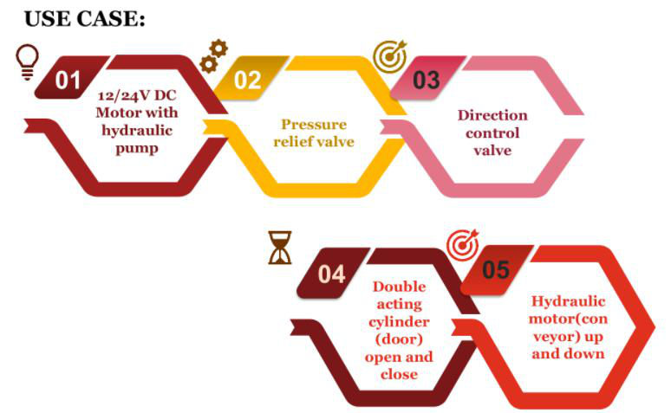
Technology stack & use case

Slide 11
Prototype & Sample Output
May include the image of the designed prototyping model / relevant pictures / Sample output image

Slide 12
Analysis:
It can filter 5 liter water inside practically 90 minutes. By using solar panel ,charging of battery is extremely successive.
● Nearly 10-15 liter water can be filtered ordinarily with this purifier, which is undoubtedly better compared to other existing solar powered purifiers monetarily.
● It has wheels that gives mobility . It tends to be utilized around evening time or turbulent days with the assistance of battery. Battery can be charged by power if there should arise an occurrence of back to back turbulent days.
● This paper centers around monetary and straightforward plan of solar power water purifier.
● This item is absolutely eco friendly. In expansion to having no carbon dioxide discharges, the Solar Water Purifier doesn’t create any noise .
● Proper security steps ought to be taken as heat and electricity are involved.

Slide 13
Cost Benefit Analysis (List of Components / Service Used)
S.No | Component Name | Specification (IC number or Range or Value) | Unit Cost | Total Cost
1 | Solar Panel |  | 4500
2 | Battery |  | 500
3 | Filtering Column |  | 50
4 | Condenser |  | 800
5 | Inverter |  | 1000
6 | Controller |  | 1000
7 | Heating coil |  | 250

Slide 14
References :
WHO (World Health Organization), “Report on Bangladesh- where simple changes in practice could save lives”, Bangladesh.
[2] Ogot, Madara. (2004). EMS models: adaptation of engineering design black-box models for use in TRIZ

